Slide 1
BlueBikes Final Project
File created on: 5/6/2024 8:17:21 PM

Slide 2
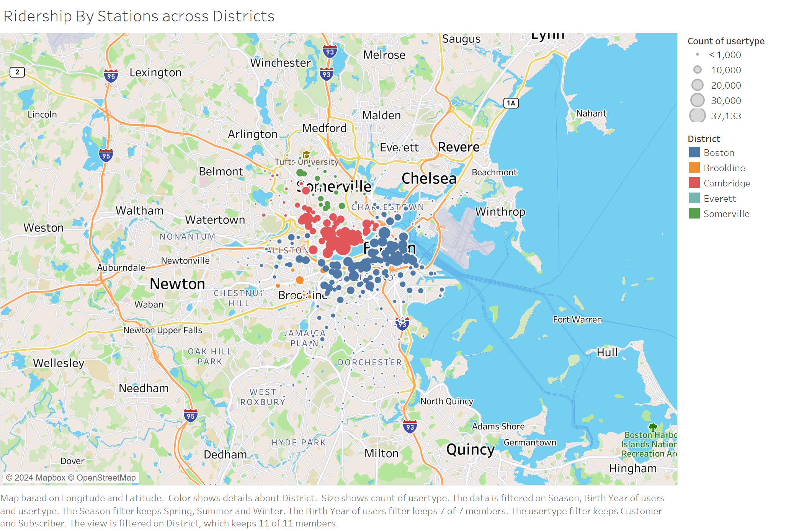

Slide 3
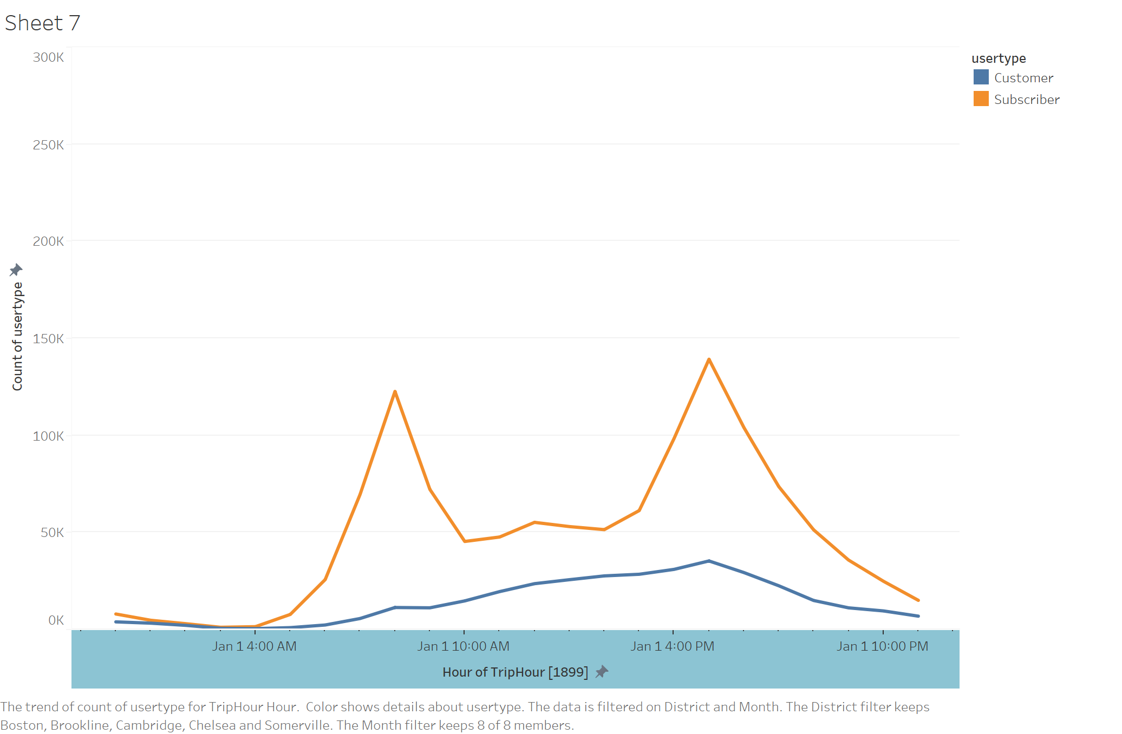

Slide 4
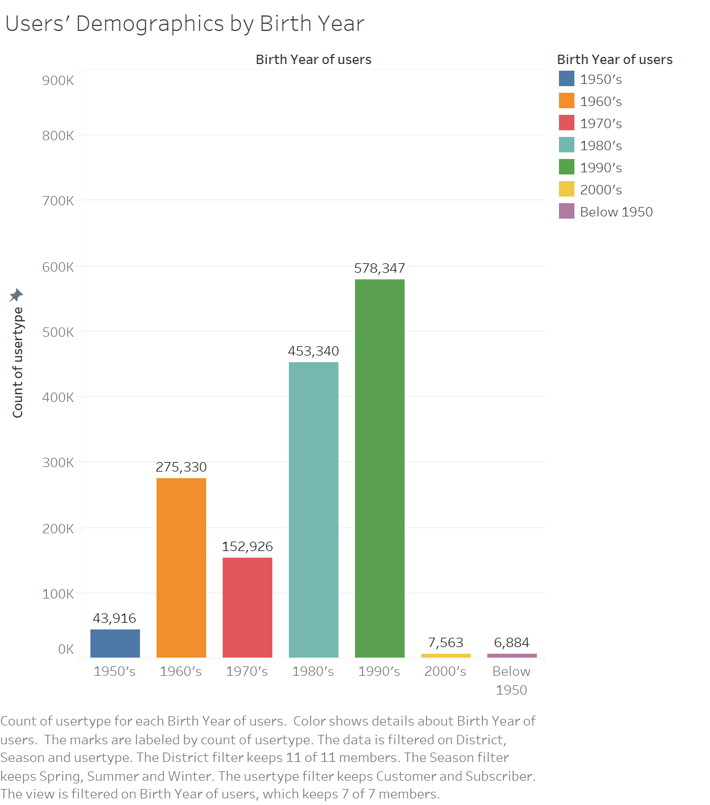

Slide 5
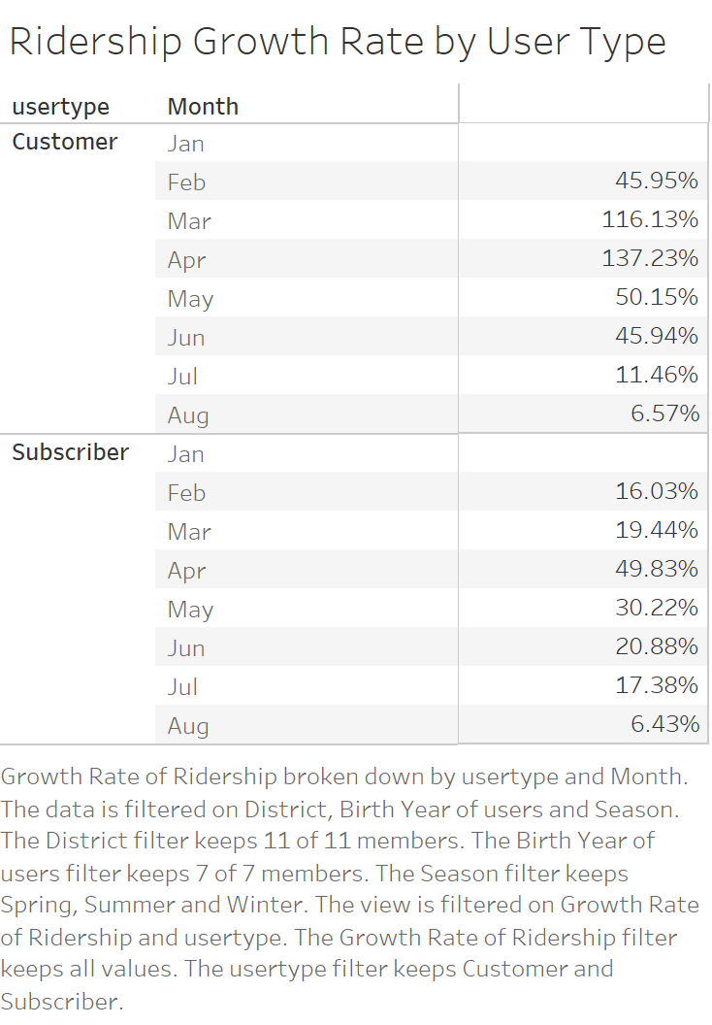

Slide 6
